Slide 1
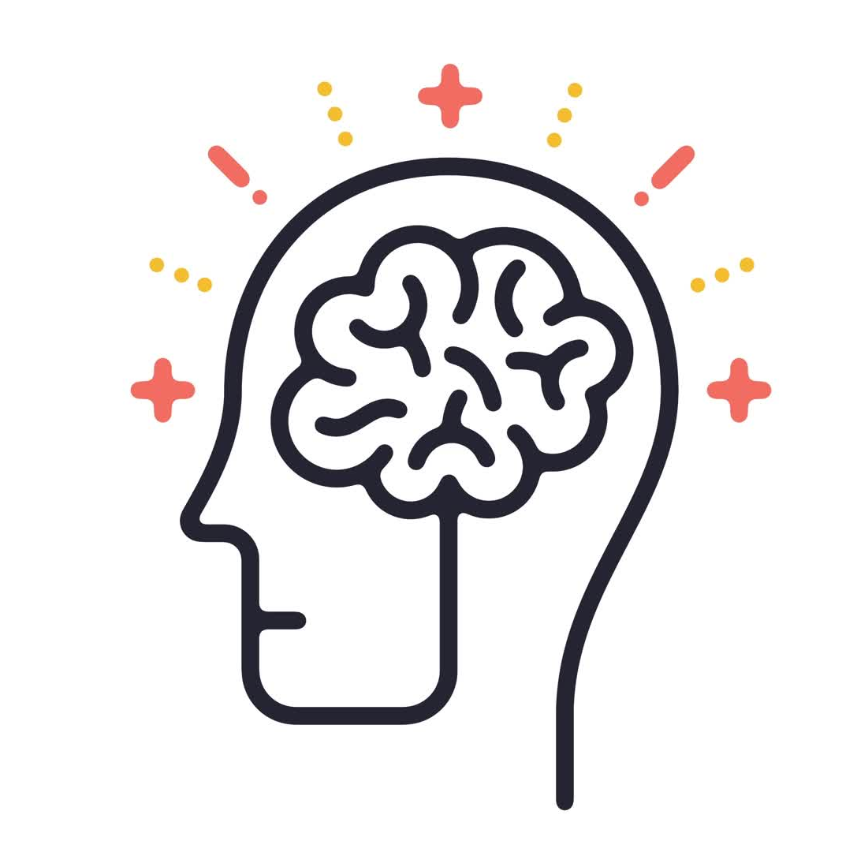
Mental Health Gateway
By-
Sanat Popli
Bhagya Trivedi
Nisha Ravi Sirdesai

Slide 2
Objective
The main objective of this Project was to create a prototype which will help to detect the mood of a patient 24*7 , after injury trauma.
There will be 2 moods of patient/person ie happy/sad and it is often observed that after accidents and injury , during the time of recovery patients often gets depressed and some times this led to anxiety and this effects them mentally.
So to safeguard them from depression we created this model which will keep surveillance of the patient 24*7 , so that if patient feels sad by any chance then he/ she may get help as soon as possible.

Slide 3
The tools we Used
Python3 for machine learning algorithm development.
(Tensorflow, Keras, imutils, OpenCV)
Html/CSS/Java Script for the front end development .
Flask for backend development/ connecting the frontend with the machine learning.

Slide 4
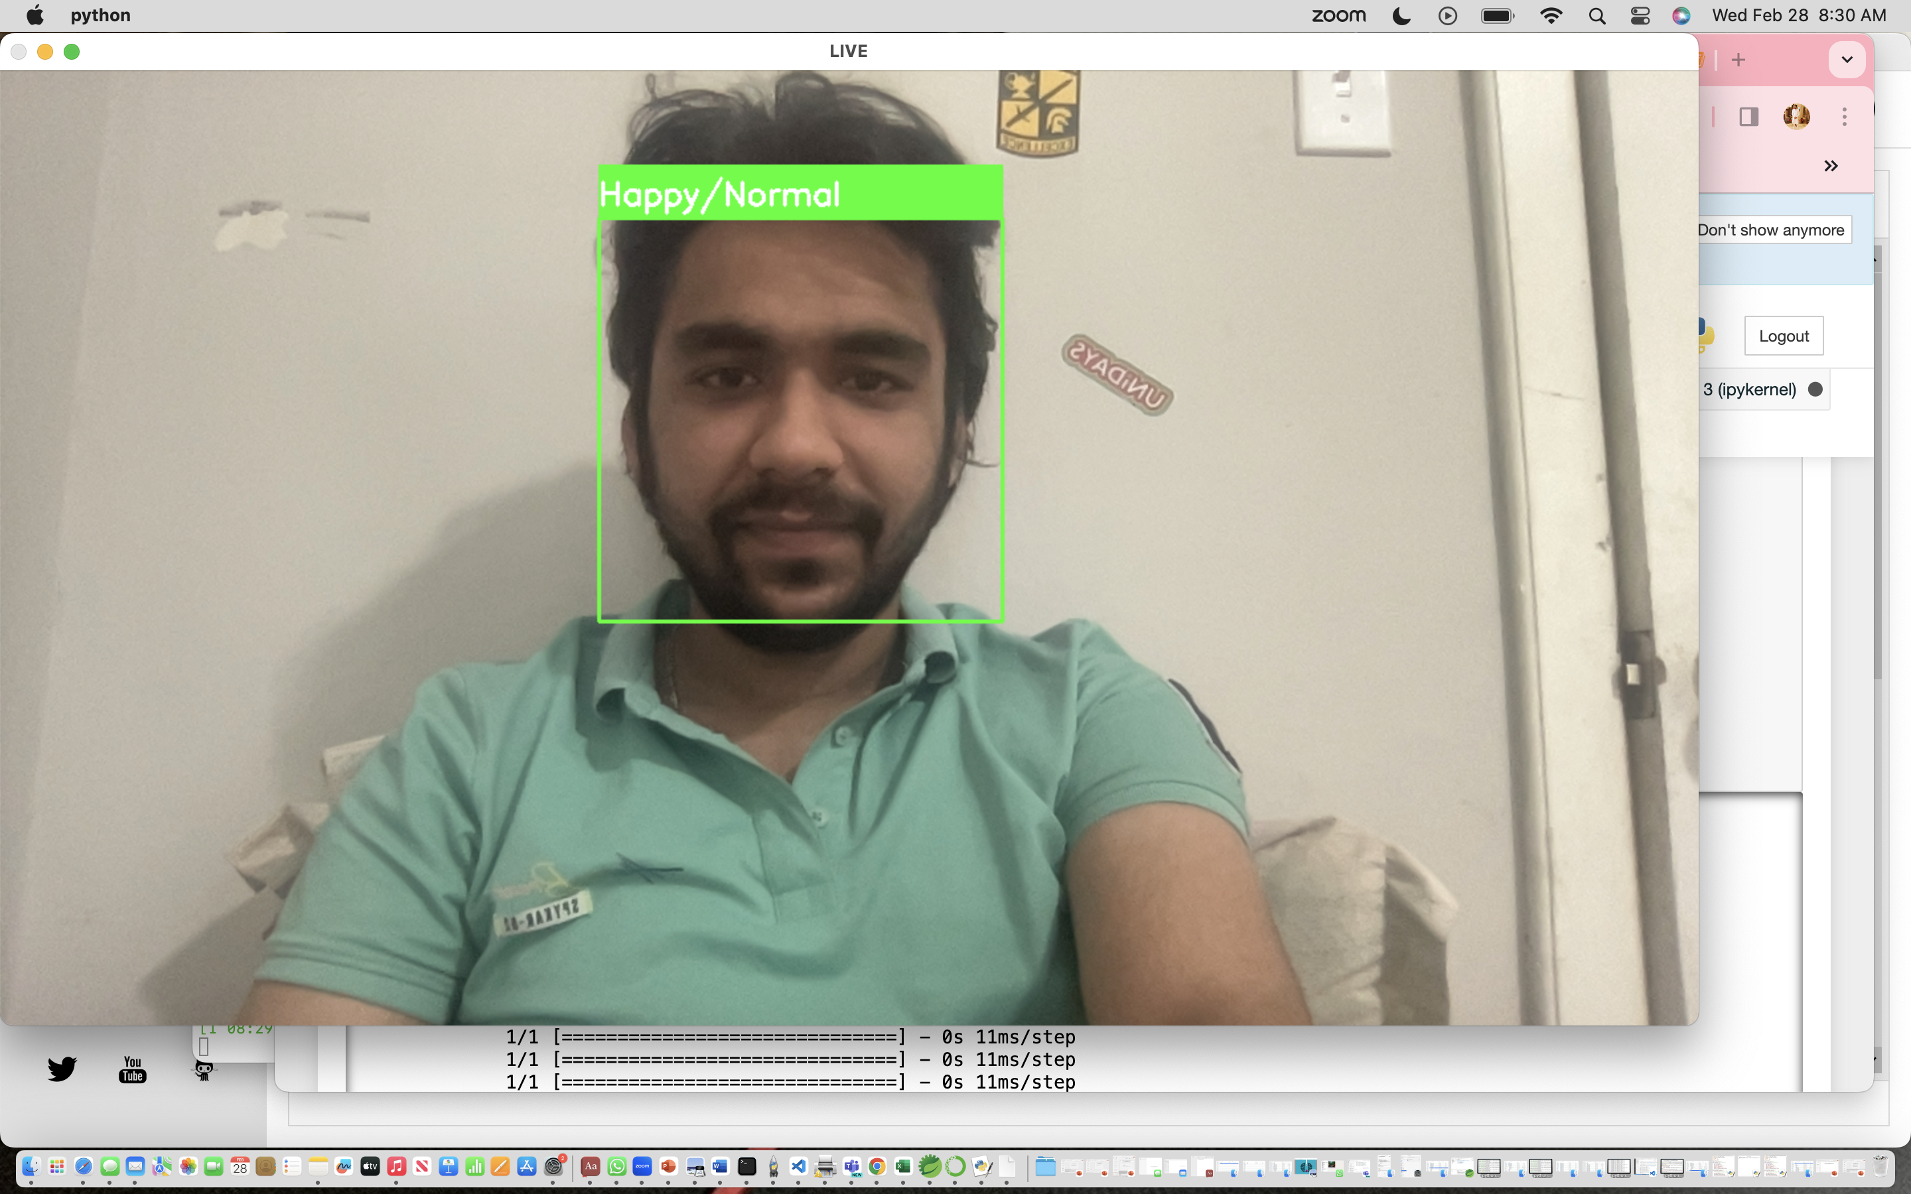
Implementation Sample-AI model

Slide 5
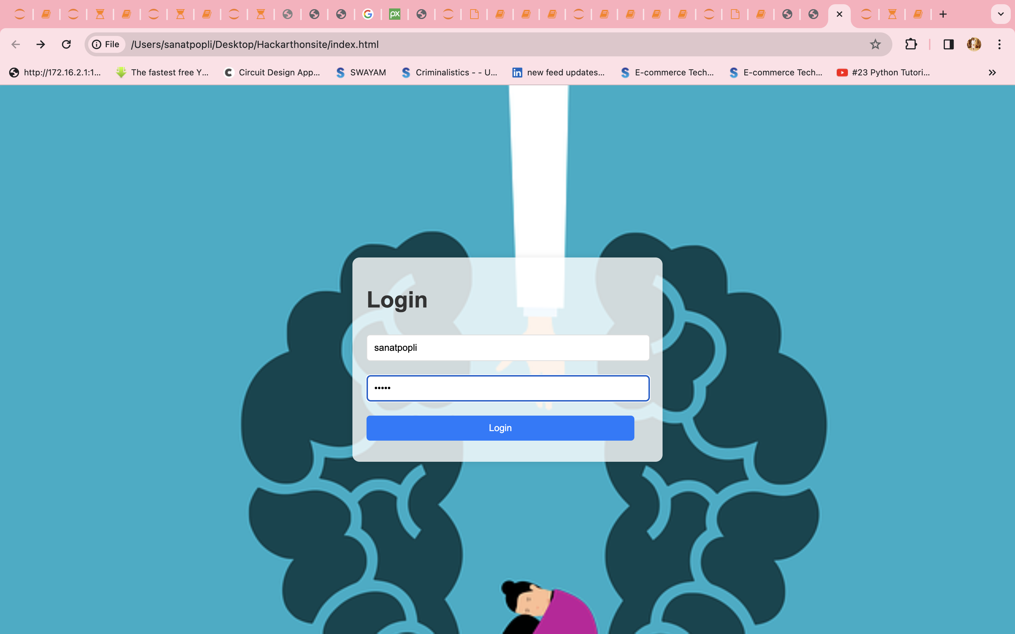
Implementation Sample Front end

Slide 6
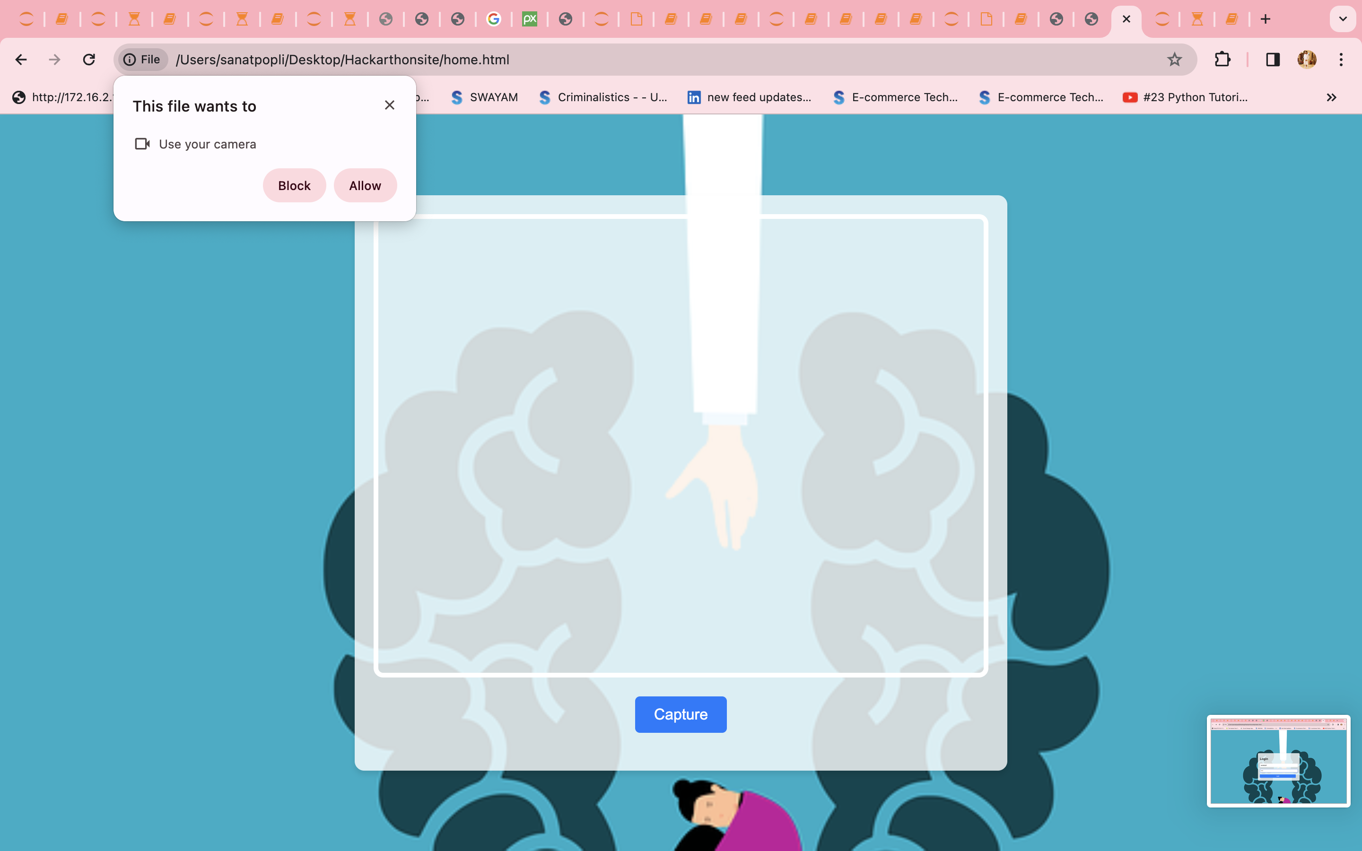
Implementation sample Frontend

Slide 7
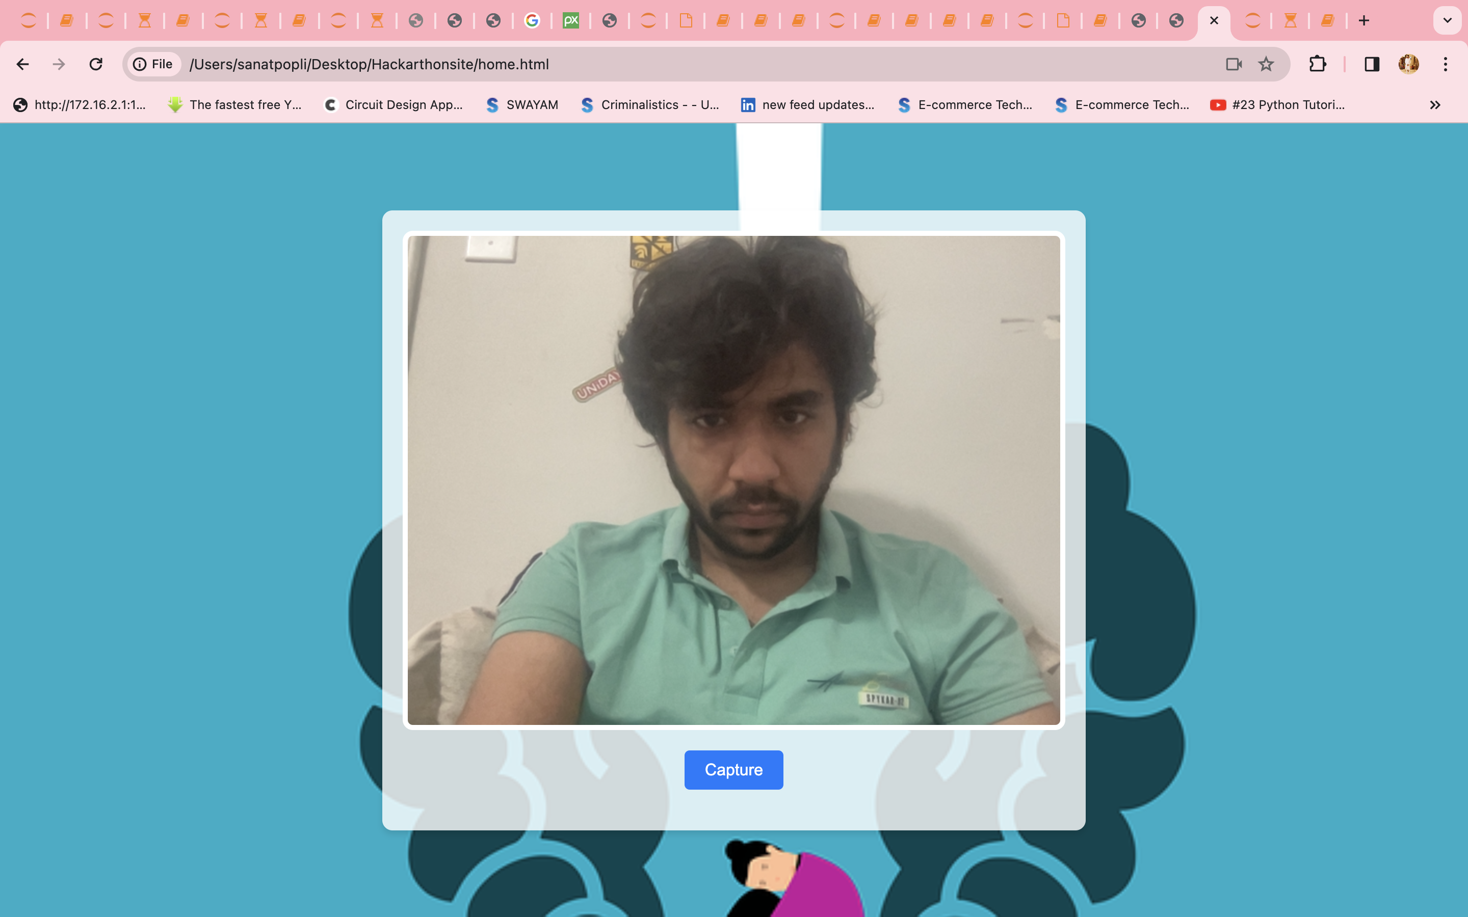
Implemenatation Sample Frontend and backend

Slide 8
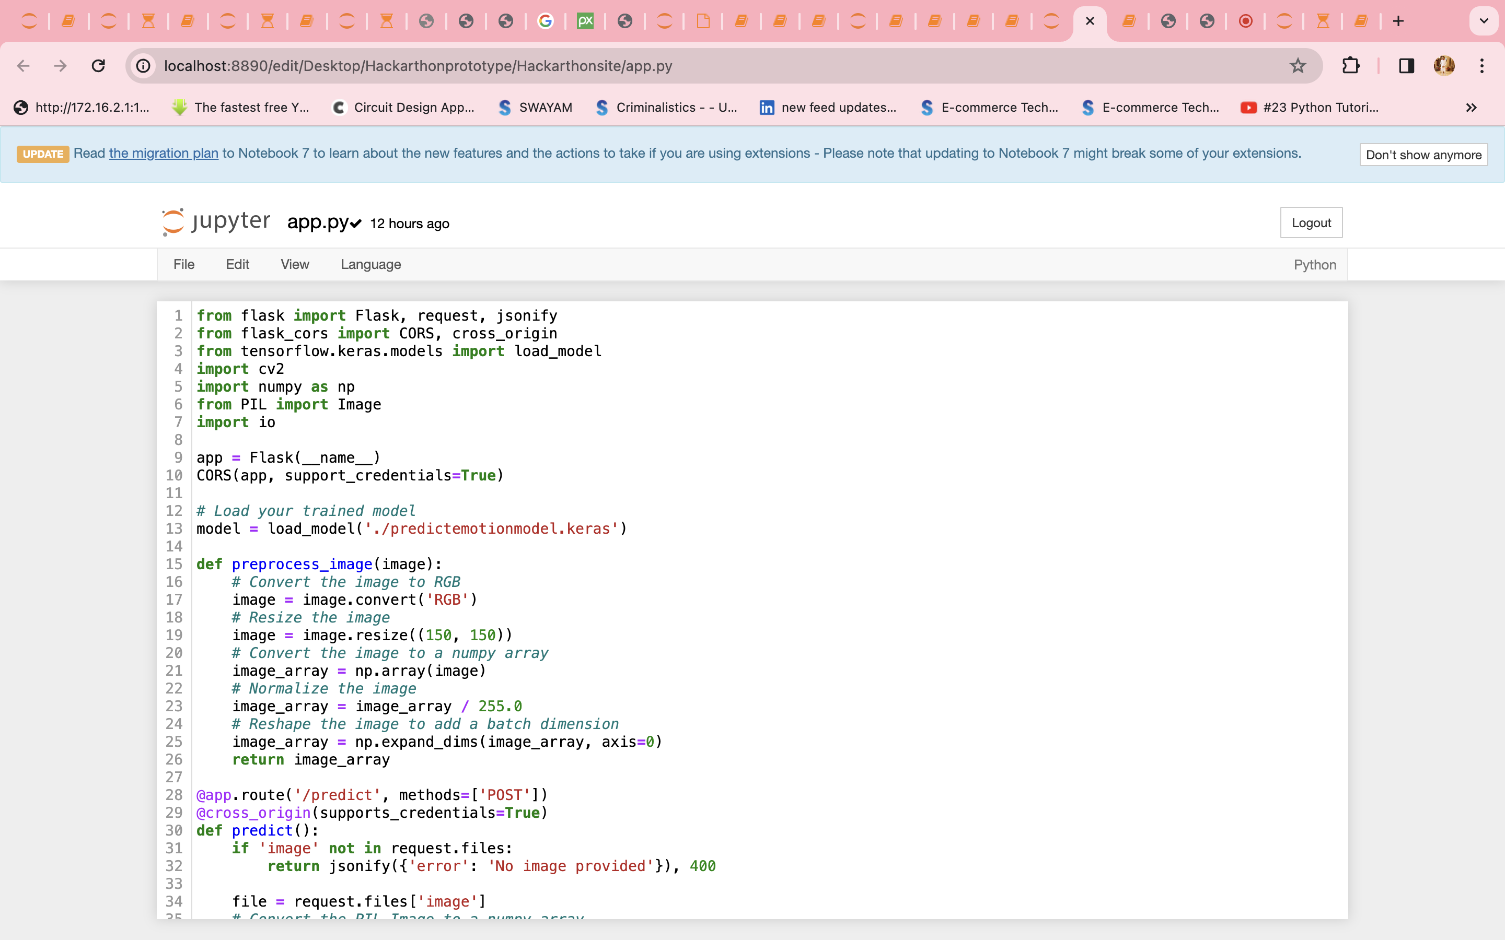
Implementataion sample Backend/Flask

Slide 9
References
https://chat.openai.com/c/29b9d7b9-f8ee-42a8-a67b-aa36c0f4e275
https://drive.google.com/drive/u/0/folders/1uaTe2Iy9NMovOlwko4ms3ePWd9ic453w

Slide 10
Thankyou

